Slide 1
Unit based width variants of glyphs for balanced justification
Typography and typesetting

Slide 2
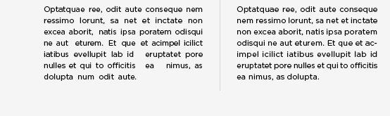
Starting point
Apart from the fact that Swiss typography prefers left-aligned typesetting to justification and strictly rejects the modification of fonts to achieve an outer form, in everyday use for magazines and newspapers there is a regular need to adapt the content to the length and form.
These adaptations are achieved by changing the spacing between letters, words and sometimes also lines or the scaling of characters. As the adjustments have a detrimental effect on the typographical qualilty of the text and thus also the readability, I am looking here for a method that can be used more harmoniously and reduces the disadvantages that certainly arise.
Right: enhanced justification without rivers

Slide 3
Investigated Solution
The method of unitization of glyph shapes should form the basis and adjustments should be made using different width variants of glyphs letters, without an effect on the stem widths or the rhythm of the characters.
A usable font shall be created and used to investigate whether the unitized scaling of glyphs is better suited vs. the continuous scaling of glyphs to reduce the disturbances in legibility perceived by the average reader.

Slide 4
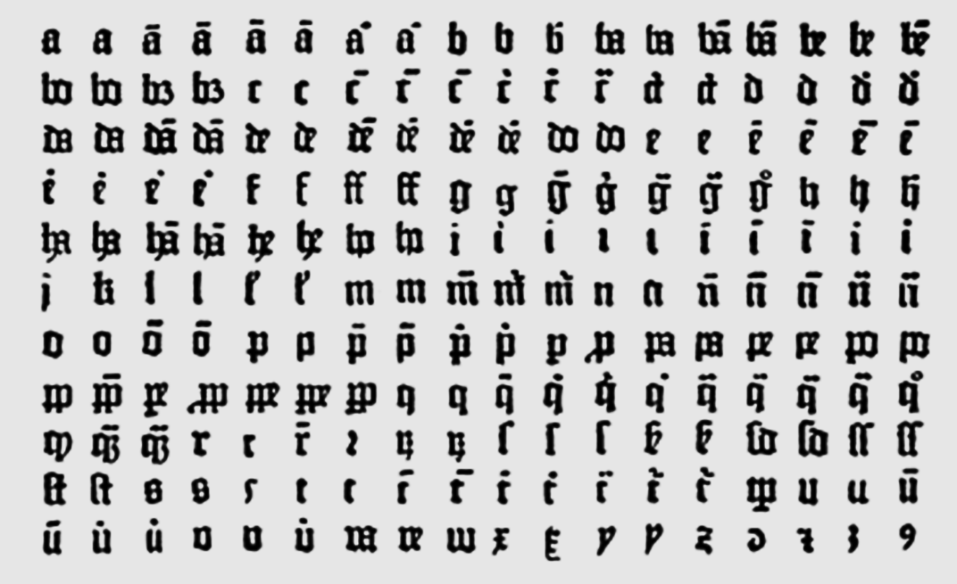
Historical and existing solutions Gutenberg
Gutenberg not only used a variety of ligatures and abbreviations, but also two versions of characters in different widths. This enabled him to fill the columns exactly without having to vary the empty space extensively.
In addition, he also used the right-hand edge for overhanging elements.
The result is a homogeneous typesetting that avoided rivers in the text and guides the eyes along the line to achieve good readability.
Lower Case characters from Gutenberg

Slide 5
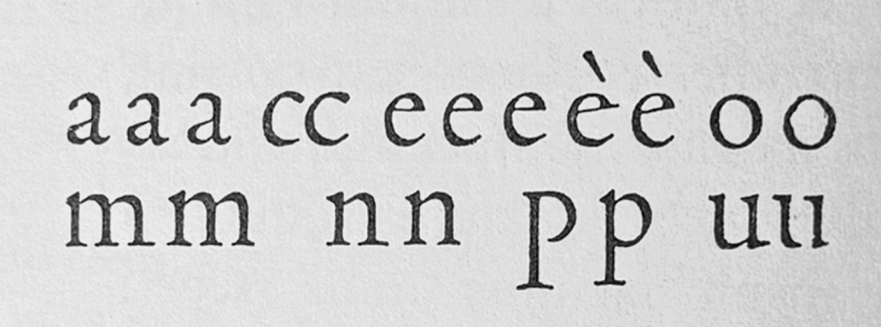
Historical and existing solutions Griffo
In Manutius De Aetna 1495 edition, Griffo also provided up to three different variants. Giovanni Mardersteig assumes that he wanted to “regain the liveliness and smoothness of the manuscript, as the Venetians of the time were accustomed to handwritten books and the uniformity of the printed page was held in low esteem”.
Variant characters from Griffo

Slide 6
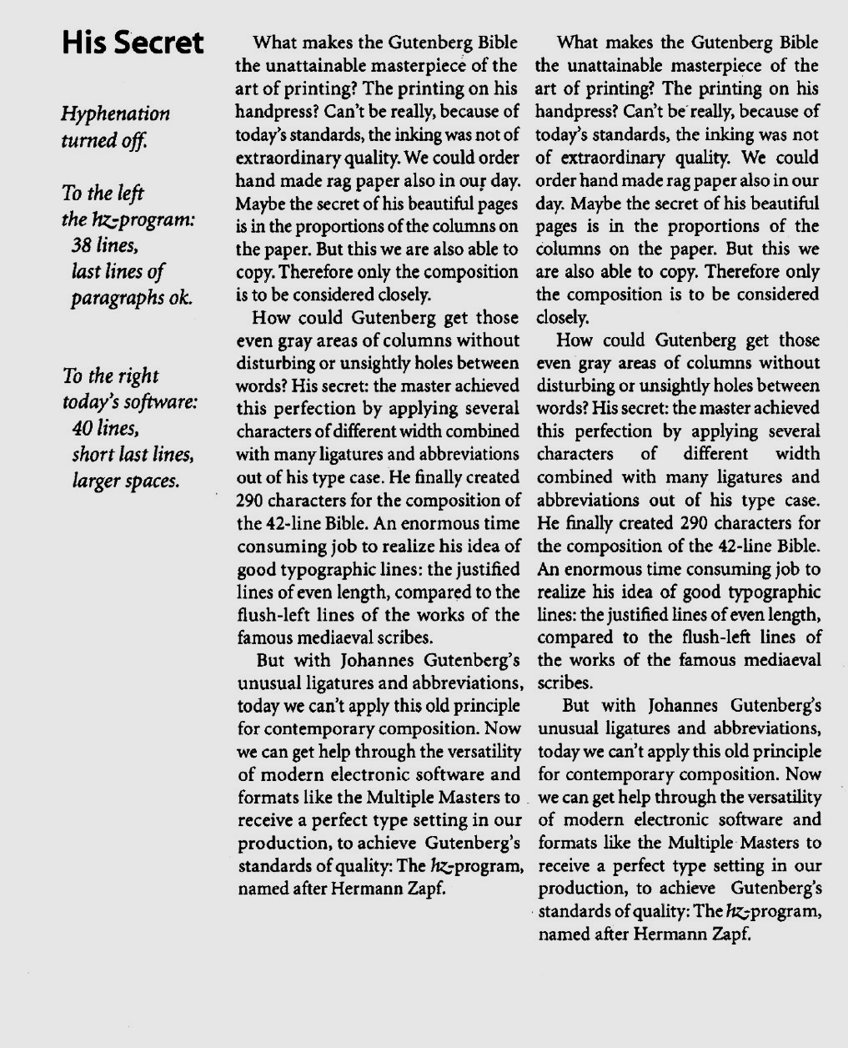
Historical and existing solutions Zapf
The typeface designer Hermann Zapf invented in cooperation with URW the Hz-Program in 1993, which changes not only the word spacing in justification to produce the perfect grey type area but also changes the kerning and the width of the characters while retaining the stem widths.

Slide 7
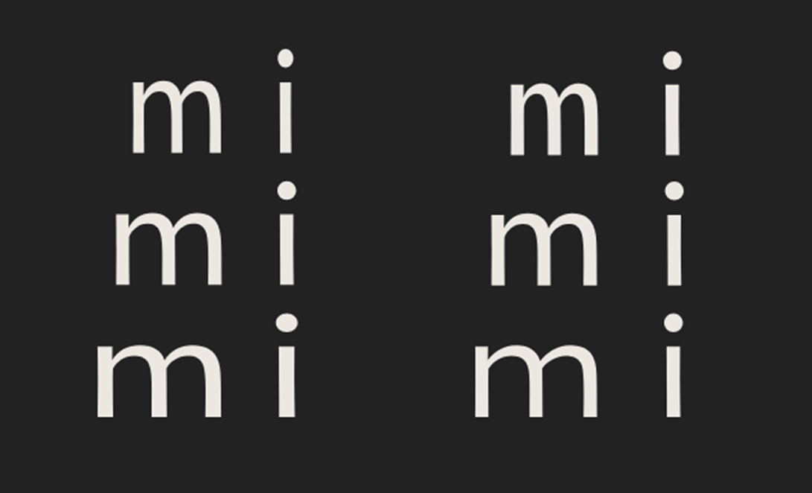
Historical and existing solutions Adobe
The Hz-program was patented by URW (expired in 2010) and was aquired by Adobe for inclusion as line-breaking/justification algorithm in the InDesign application.
But InDesign's way of varying glyph widths is simpler than that of the hz-program, and the result is inferior typography. When the hz-program scales the characters horizontally, the vertical strokes are kept the same.
Left: Glyph scaling changes also stem widths

Slide 8
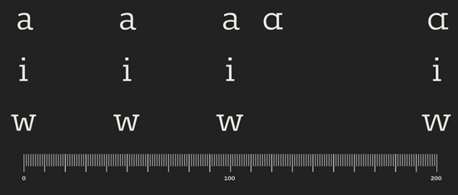
Historical and existing solutions Ammon
Johannes Ammon (finaltype) presented in 2019 his experimental approach for better web typography and created a variable typeface which manipulates the glyphs according to their capabilities or alternate the shapes completely, which is used by a line breaking algorithm.
Aproach for different widths incl. alternates

Slide 9
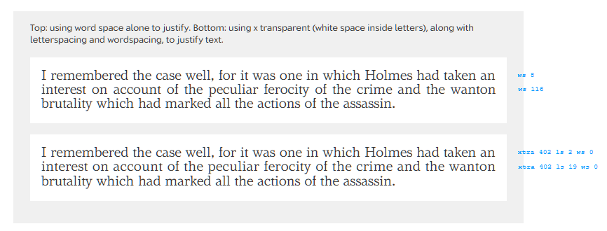
Historical and existing solutions Fister
At the ATypI 2022 Lasse Fister provided a Tech Talk about responsive spacing in connection with variable fonts. Using the example of the Roboto Flex font, the parameter wdth alters the width of the glyphs in the X dimension to fine-tune the justification as it changes the number of characters per line.
https://variablefonts.typenetwork.com/topics/spacing/variations

Slide 10
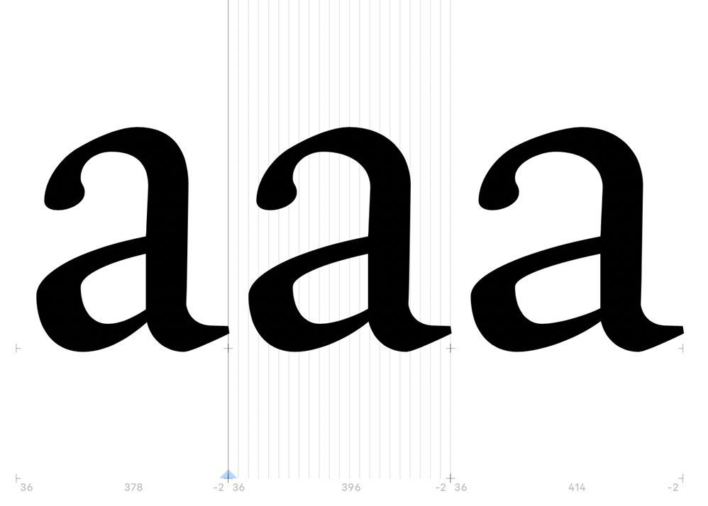
Implementation of the solution
The project will use the above findings based on the latest font technologies to develop a font prototype.
Unitization is also applied to the characters and a comparison is made between a fixed stem interval (/n in constant width) versus a parameterized stem interval (/n as a flex value for the rhythm).
The limits of ordinary forms are to be explored, how narrow or wide each glyph can be depicted without painful disturbances. This can be done differently for each glyph, e.g. depending on the generalized shape form.

Slide 11
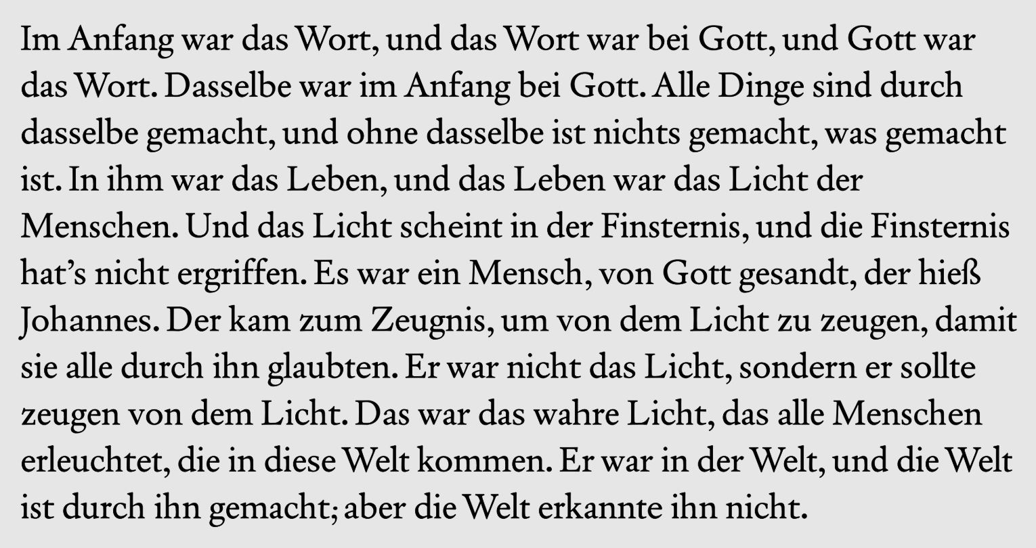
Test procedure for evaluation
In a preliminary test as a riddle, I used a variable font that provides the character widths for the letters /a /d /e /h /r /s /t (next to /n, the most frequently used letters in German texts) in three variants and mixes them in the output (using Opentype calt-Feature). The test has shown that the different character widths can be successfully hidden using this method.
Riddle for testing conspicuousness of width variants

Slide 12
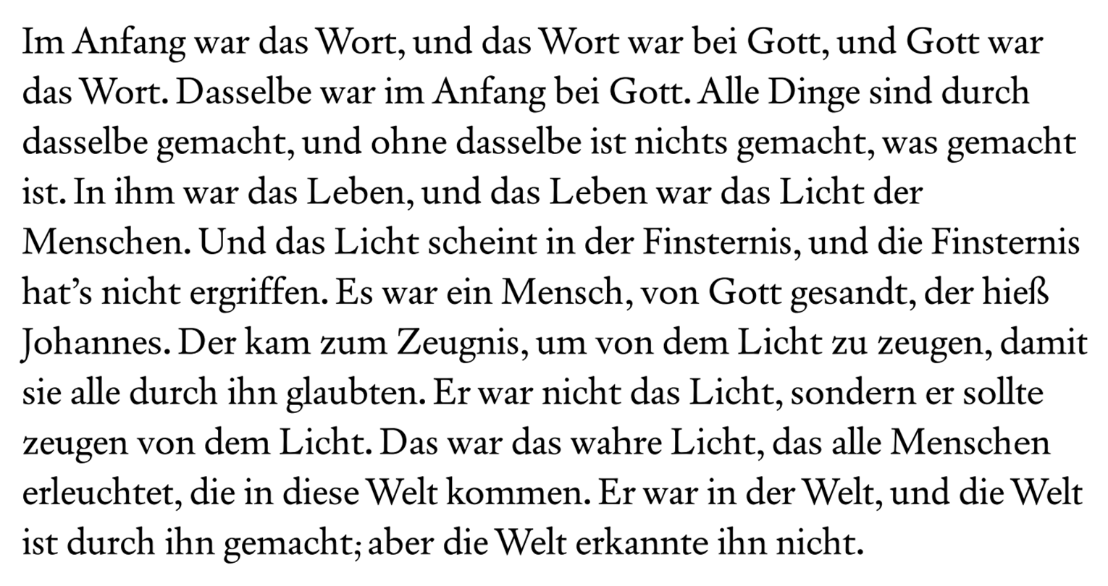

Slide 13
Project deliverables
As a result, fonts should be available and text examples created with which the following tests can be carried out:
Traditional scaling as reference (changing stem thickness)
Variable scaling (stepless method e.g. wdth axis)
Unitized scaling with fixed step intervals
 | Stem | Counter
Traditional Scaling | flex | flex
Variable Scaling | fix | flex
Unitized Scaling | fix | stepwise
Comparision on methods.

Slide 14
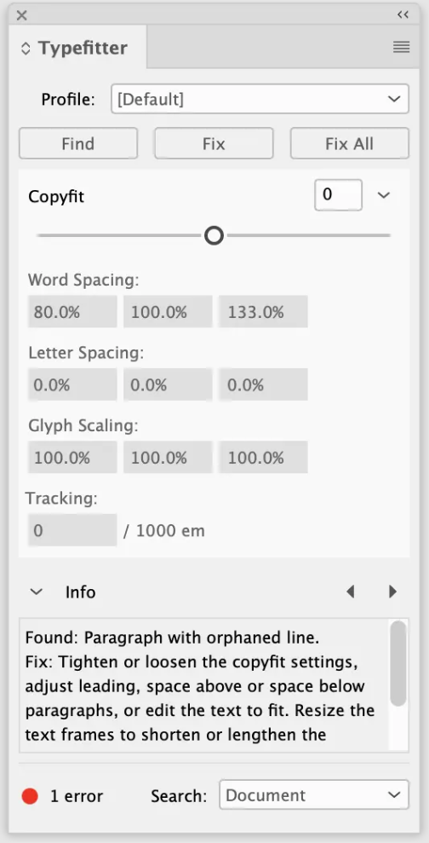
Future practical application scenario
For interactive use, the setting can be applied individually to the selected text in an additional panel (e.g. InDesign plug-in)
Based on the fill level of design containers, a server-side process can determine the necessary parameters for the font and carry out the output completely automatically.
Example Plug-In

